Slide 1
Augment AEC Add-on Value

Slide 2
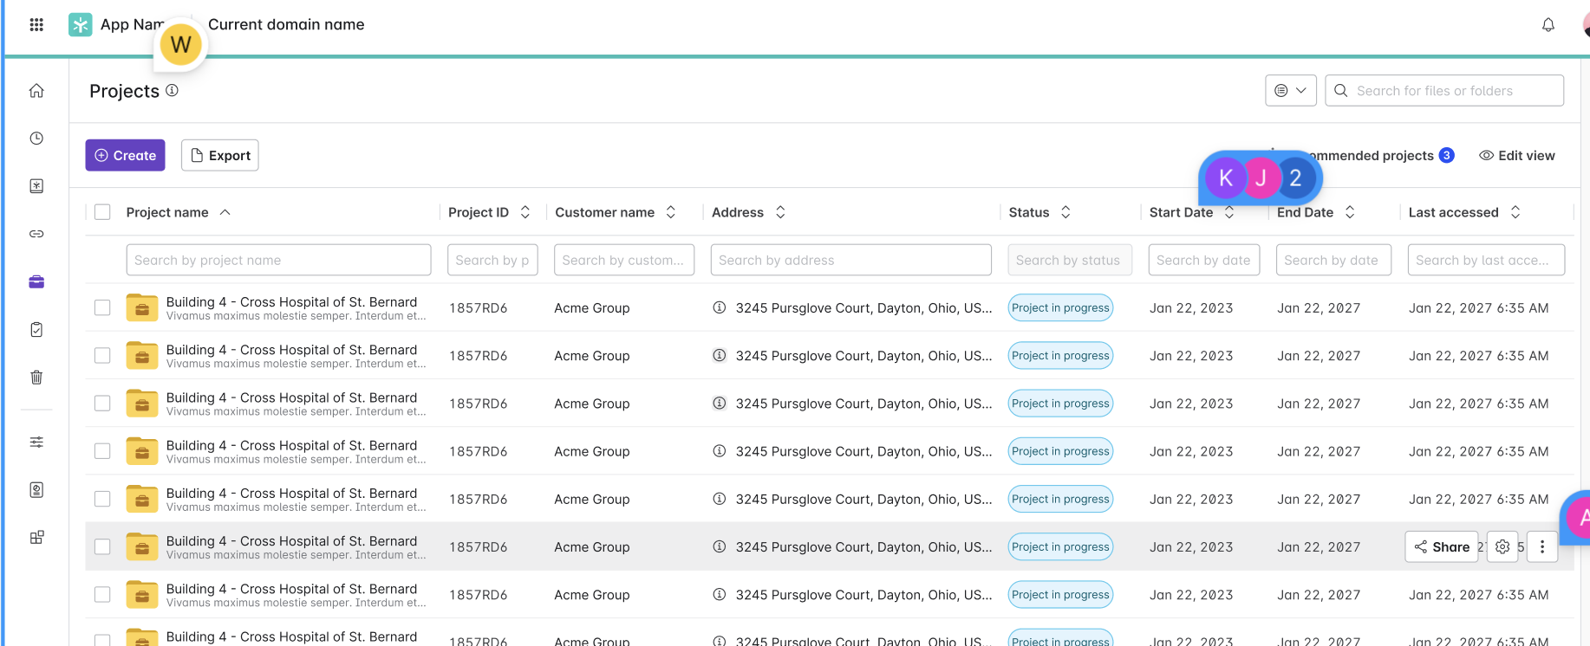
[AEC] Project Center
Problem Statement
Adoption of project folders in Egnyte is growing, just not as quickly as we had hoped. One area in which Egnyte is lacking is a need for better visibility into project folders. Customers need to be able to quickly and easily get an overview of their projects to understand things like “which projects are in progress” and “which projects are in California?”. A dedicated page/section where users can find all information related to their projects will satisfy this need.
User Story
As a user, I want to view a list of all project folders in my domain, so that I can get an overview of the projects to which I have access.
Feature Description
• Possibility to search, sort and filter project list using project metadata,
• Possibility to create a new project from the project center context
• Possibility to review project recommendations.
View in Productboard
CFS-64852
Link to requirements

Slide 3
[AEC] AEC Image Classification - Phase 2
Note: This is phase-2 of the feature. Phase 1 was completed in 2024. Phase-1 completed the auto identification of items, so the feature is usable by end users. However, there are additional UX and filtering enhancements that were postponed and are grouped as phase-2.
Problem:
Construction progress photos are vital to documenting the progress of a construction job site. They allow users to review the state of a project at a given point in time which is commonly required for offsite personnel to receive progress updates, for users to review constructibility issues, or even to dispute legal issues later on down the road.
However the value of these images is often greatly diminished because there are many challenges with capturing, organizing, and finding the photos that are needed. Egnyte helps support the capture/upload of job site images with the Smart Upload feature today. This feature helps users to get images off a mobile device and into the appropriate project folder in the cloud. Once the photos are dumped into a common folder however, users can have difficulty sorting through them and finding a specific image that they need.
Solution:
After a user creates a project folder, any images that are uploadedwithin that project folder are automatically classified and taggedwith the built-in classes trained on AEC specific images. Thisallows users to search and filter their construction progress photos bythe contents within the image.
View in Productboard
No Jira Link
Link to requirements

Slide 4
[AEC] Native ACC Integration 1-way
Build a direct integration between Egnyte and Autodesk Construction Cloud (ACC) allowing users to sync files 2-way from ACC to Egnyte
Requirements -https://egnyte.atlassian.net/wiki/spaces/AEC/pages/746651753/ACC+Integration
Figma -https://www.figma.com/design/LlzP9CPnCoI44cAH0oKlPU/Egnyte-to-ACC-bi-directional-connection-%5BUX-3132%5D?node-id=201-376&node-type=canvas&t=3IHBOcnMUsa8sDuO-0
View in Productboard
DEL-40646
Link to requirements

Slide 5
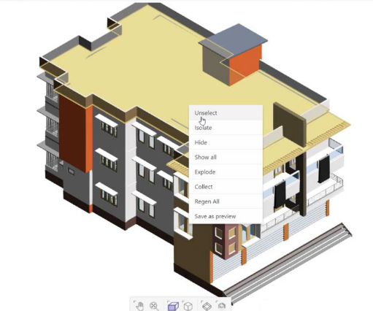
[AEC] BIM Preview Enhancements
Problem:Project owners, field technicians, or estimators are periodically required to review BIM design files and provide feedback to the VDC team. They do not have AutoCAD or necessary applications to view these files. Our existing BIM preview capabilities address this problem. However, the reviewers lack the advanced capabilities needed to provide relevant feedback.
User Story:As a reviewer of the BIM design models, I want advanced capabilities (zoom in/out, isolate families, isometric views) to properly view a 3D BIM model and provide relevant feedback to the VDC team.
Description:This enhancement improves the usability of the BIM previewer by providing richer capabilities required for annotation.
View in Productboard
SRV-2516
Link to requirements

Slide 6
LS Mid Market Capabilities

Slide 7
Drafts Creation & Management
Problem Statement
1 - 2 sentences describing the problem we are trying to solve
User Story
Format: As a [user role], I want [goal], so that [benefit]. 1-2 sentences
Feature Description
• High-level requirements
• No need for detailed acceptance criteria
• Three bullets max
View in Productboard
LS-4151
Link to requirements

Slide 8
Optional Effective End Date
Problem Statement:
Some forms of Controlled documents, such as validation Documents, brochures, and clinical trial protocols, do not have set expiration or end dates. Customers prefer not to have end dates for these types of documents.
User Story:
As an authorized Controlled Document Management app admin, Egnyte domain admin or Category Manager
I want to be able to set the Effective until date to optional for a specific subcategory
So that the users can leave the Effective until date blank while making documents effective/future effective for the selected subcategory
Feature Description
• The admin users should have a setting to set the “Effective until” date optional for a specific subcategory. When available, the users can mark the Effective until date optional while making the documents effective/future effective.
View in Productboard
LS-4155
Link to requirements

Slide 9
Support for CAPAs, Deviations, and Event Data
The description is empty.
View in Productboard
No Jira Link
Missing requirements

Slide 10
Permissions Management

Slide 11
Data Owner - Scheduled Permission Reviews
Admins and Data Owners need the ability to schedule periodic (monthly, quarterly, yearly) permission reviews. The following requirements need to be completed
Scheduled Permission Review Requirements:
• Approach 2 - Scheduled Reviews from Permissions Tab and SC Tab
View in Productboard
DEL-22618
Link to requirements

Slide 12
Elevate Desktop App Capabilities

Slide 13
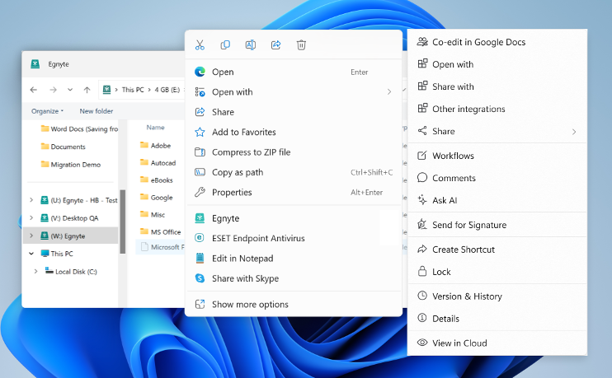
Windows 11 Context Menu Support
Problem Statement
Windows 11 moved the regular File Explorer context menu behind a "Show more options" menu and introduced a new context menu. Users cannot find the Egnyte context menu and this reduces engagement with richer functionality.
User Story
As a user I want the Egnyte context menu to be available on the top-level File Explorer context menu so that I interact with my Egnyte files directly from the desktop.
Feature Description
• Egnyte option will be exposed on the top-level File Explorer context menu
• Clicking the Egnyte option will open the Egnyte Actions "menu", providing access to a wide variety of file-level actions (link sharing, Ask AI, eSig, PDF editing, etc.)
View in Productboard
EGD-21555
Link to requirements

Slide 14
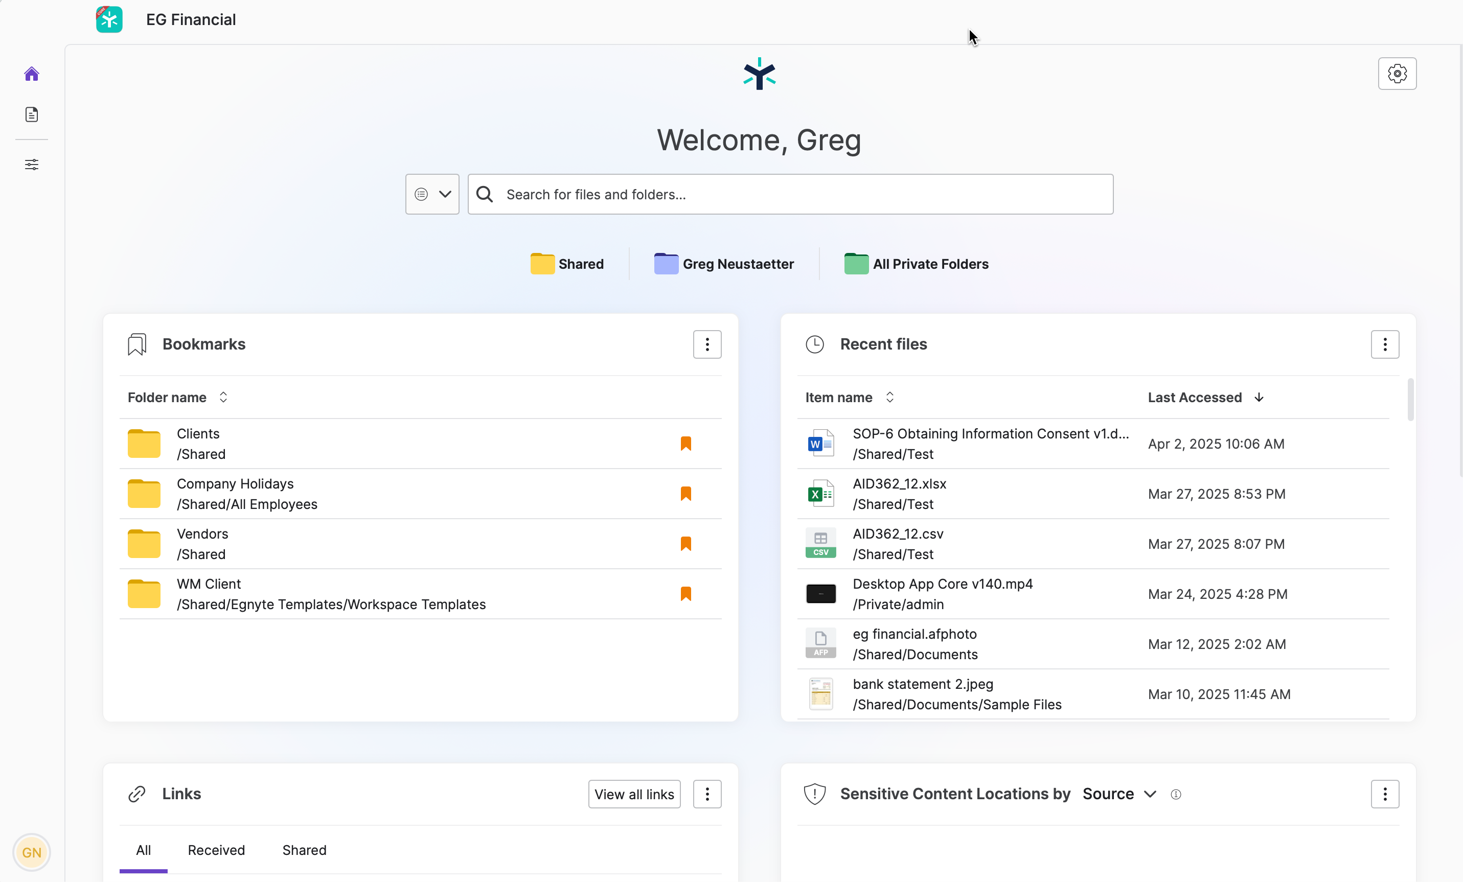
Application UI - Windows
Problem Statement
The majority of Egnyte users are Desktop Users but many new collaborative features are only available on the Web UI today. This can result in poor adoption and user experience challenges for end users.
User Story
As a desktop user, I want to access richer Egnyte functionality on the desktop, so that I don't need to open the Web UI to access them.
Feature Description
• First-class application for the Desktop App (as compared to current widget approach)
• Embed Web UI home page and search capability
View in Productboard
EGD-20540
Link to requirements

Slide 15
SCDA Win - Beta-2 Readiness
Problem Statement
Users in AEC and media work on massive and complex files. They face a challenge of working on these files directly from the cloud
Feature Description
We have introduced the Adaptive Streaming and Block Caching technology in Desktop App. The Beta-2 project goal is to enable up to 100 AEC domains with block cache and get feedback on the following applications:
1. AutoCAD
2. Civil 3D
3. Navis
4. Bluebeam
5. Acrobat
View in Productboard
EGD-23096
Link to requirements

Slide 16
SCDA Mac - Beta-0 Readiness
What is the problem?
Users in media work on massive and complex files. They face a challenge of working on these files directly from the cloud
How do we solve it?
We have introduced the Adaptive Streaming and Block Caching technology in Desktop App. The Beta-0 project goal is to enable up to 5 media domains with block cache and get feedback on the following applications:
1. Adobe Premiere Pro
2. Illustrator
3. Photoshop
4. InDesign
View in Productboard
EGD-21559
Link to requirements

Slide 17
Top Customer Requests

Slide 18
Content Safeguards - Group-based Link Sharing Controls - Phase 2
Problem Statement
Currently, when applying a Content Safeguard policy, the policy will apply to all roles/groups and all users. Several customers are looking for more flexible CS policies where some roles/groups have different link sharing ability than other groups.
User Story
As an S&G admin, I want to create flexible Content Safeguard restriction and exception policies to match my organizations specific group requirements.
Feature Description
Create Content Safeguard exception policies that support use cases such as:
1. Role/Group A can create password-only links on folder A, but Role/Group B is only allowed to create links to specific users on folder A
2. Allow administrators to share public links but prevent other users
View in Productboard
DEL-31667
Link to requirements

Slide 19
Provide ability to pause archival/deletion policies
Problem Statement
IPG has a workflow where they create an archival policy, it moves files to a 'warm archive' location in the main domain and then Storage Sync moves the files in the 'warm archive' to a external location. However, they only have the archival policy active for a few weeks every quarter.
User Story
Their current process is to delete the policies and then complete recreate them. That is a lot of work and they have requested the ability to either pause or recreate/duplicate policies so they can easily 're-enable' the policies on their current schedule.
Feature Description
• Frontend - provide pause/restart option for published policies
• Backend - use existing functionality to basically put the policy back into draft mode and unstamp the files that match the policy
View in Productboard
DEL-44353
Link to requirements

Slide 20
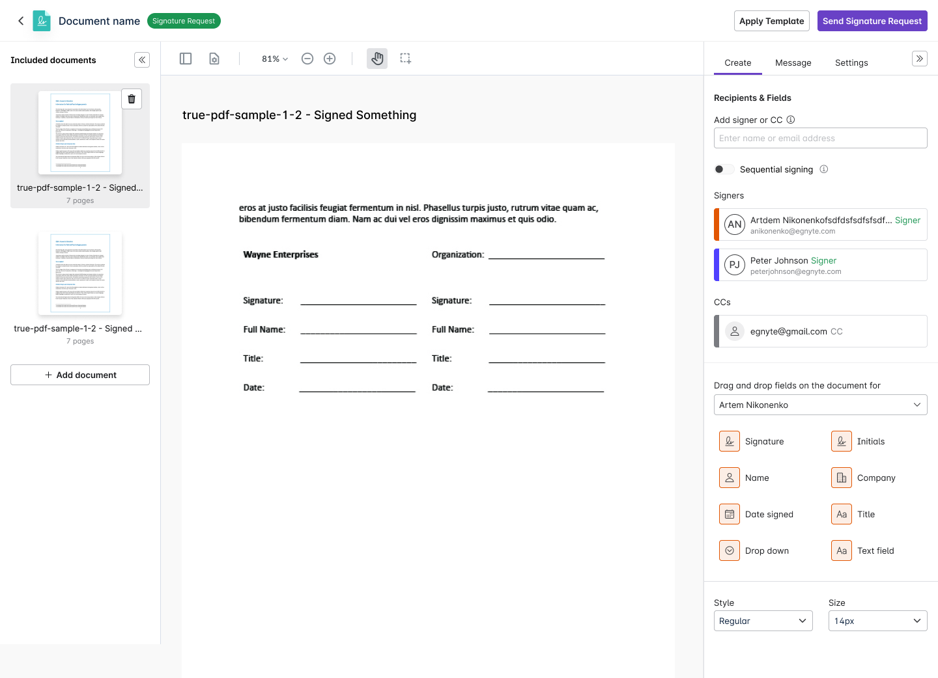
Multi-Document Envelopes
Problem Statement
With the current eSignature workflow, a user can send only one document per signature request. If a user has to send multiple documents, they have to send as many signature requests or merge the documents using PDF editing capabilities, which is inefficient.
User Story
As a signature requestor, I want to send multiple documents for signature in a single request so that I can get all of the signatures at once.
Feature Description
• Add multiple documents to a signature request
• Recipients see a consolidated set of the documents and sign them
• A single signed PDF is generated at the end of the process
View in Productboard
CFS-65375
Link to requirements

Slide 21
Bulk send eSignature requests
Problem Statement
Users who need to send a document for signature to a large number of people have to create separate signature requests for each recipient. This is inefficient and causes people to use other services for bulk requests.
User Story
As a sender of signature requests, I want to bulk send requests to save time.
Feature Description
• Use a template to send signature requests to a large number of recipients.
• The user needs to upload a CSV file that will contain emails in a column that is headed by that role. Each row will be considered as a separate request. The system will read the file and start sending signature requests.
View in Productboard
CFS-67745
Link to requirements

Slide 22
Inherit folder options to sub-folders (IPG, T&P + 7)
Problem
Today, when the folder options are changed, they do not get inherited consistently to the sub-folder tree.
• The setting that controls folder update notification gets inherited to sub-folders until it finds the folder with a manually updated option.
• The setting that controls the sharing gets inherited to sub-folders until it finds the folder with a manually updated option.
• The setting that controls who can delete/move the folder does not get inherited at all.
• Copy/move folder retains the folder options as per the source location.
User Story:
As an authorised user, I want to have folder options propagated throughout the folder tree so that I can have the same options selected on all the sub-folder trees.
Description:
We need to do the following
• We need to have inheritance applicable for the setting that controls who can delete/move the folder.
• When the user makes any change to the folder options - sharing control and/or move/delete control and/or folder update notification control - the system should evaluate if there are any manual overrides within the folder tree and if any provide the user with an option to choose whether to disregard manually overridden values.
• When the user copies/moves a folder, the folder options should get inherited from destination folder where the folder is copied/moved.
View in Productboard
CFS-64734
Link to requirements

Slide 23
Group improvements (S&L, Norr)
Problem Statement
Group management that we propose is not granular enough. Either power users are not allowed to manage groups at all, or they both can manage and create groups. Customers are asking to create an in-between role that allows for group management but does not allow group creation
User Story
As an admin, I want to give users a possibility to manage groups but prevent them from creating groups on their own.
Feature Description
• Create a role PUs Group Ownership, without allowing them to create groups on their own
• Possibility to add a group description
• Enhanced group exporting and importing - indicating group owners
View in Productboard
CFS-67268
Link to requirements

Slide 24
Scheduled report enhancements (Sequoia)
Problem Statement
Currently, only admins are allowed to create scheduled reports. This is troublesome for some of the customers, since the admins are overwhelmed with requests. Additionally, scheduled reports land in a fixed folder, to which not all customers feel comfortable sharing broadly. Having a possibility to select a folder where the scheduled report would land addresses this problem.
User Story
As an admin, I want to give power users a possibility to run scheduled reports and choose custom location for storage.
Feature Description
• Auto-archival of scheduled reports
• Custom location of scheduled reports
• Saved and Scheduled queries for power users
View in Productboard
CFS-67854
Link to requirements

Slide 25
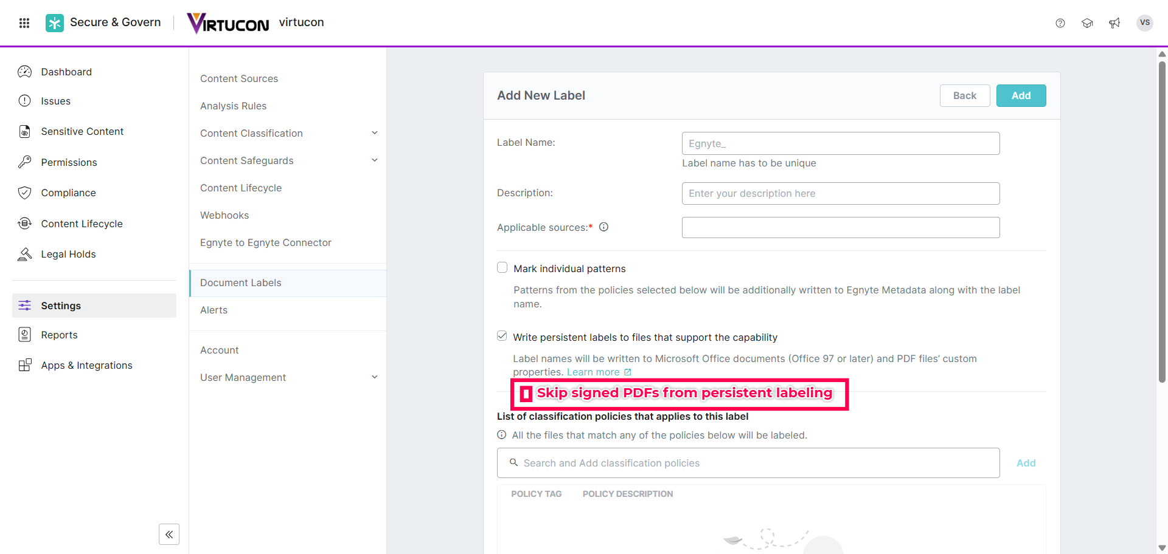
Skip signed PDFs from persistent document labeling
Problem Statement
An Egnyte Document Label when stamped as a persistent label on a signed PDF invalidates signatures on the signed PDF. This results in poor user experience and loss of user productivity as a user is required to constantly restore a previous version of the PDF before applying a signature.
User Story
As a business user I require signed PDFs to not be signature invalidated so that the integrity of the signed PDF is maintained.
Feature Description
• The Egnyte Document Label stamping process shall be enhanced to skip signed PDFs from further labeling actions
• This enhancement shall consider PDFs signed through various signing mechanisms - for example, Adobe Digital ID, Digital Signature, etc.
View in Productboard
DEL-43523
Link to requirements

Slide 26
Backup to S3 and Wasabi
What is the problem?
MSP and channel partners want to create a 2nd copy of Egnyte data on S3 or Wasabi storage. This is in order to meet their compliance needs.
How do we solve it?
Make External Replication available to MSP's and partners. Have a simplified UI workflow to enable replication
View in Productboard
DEL-45080
Link to requirements

Slide 27
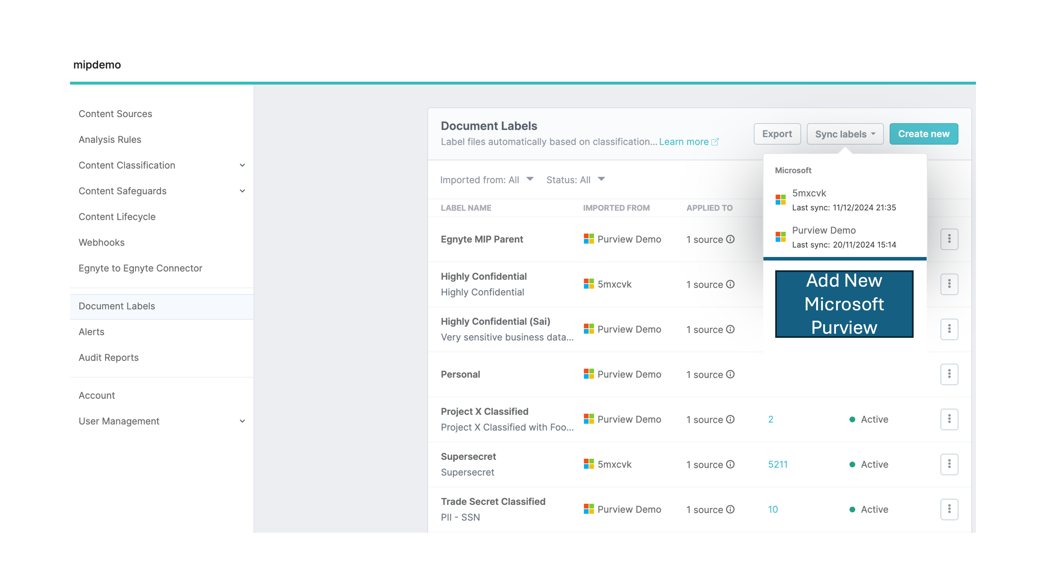
Decouple labels permissions from classify and govern permissions
Problem Statement
Currently on a Microsoft content source, permissions for labels are tightly coupled with permissions for classify and govern. This presents a problem for customers who require labeling only but have to authorize permissions into their Microsoft environment for classify and govern as well.
User Story
As a business user I require decoupled permissions scope for labels and classify and govern so that I authorize only the level of permissions required into my Microsoft environment.
Feature Description
• Create a new app scope for Purview label permissions only
• Remove Purview label permissions from the current classify and govern app scope
View in Productboard
DEL-43506
Link to requirements

Slide 28
Shore the Core

Slide 29
Reduce false positives associated with Windows system activity
Problem Statement
Currently, Microsoft doesn't provide enough information to determine whether a user or system action is causing the anomalous file access/download activity for Windows Explorer. This causes a lot of false-positive detections as well as many ESCs.
Feature Description
Improve our ability to distinguish between user and system access/download events for Desktop App.
View in Productboard
DEL-31632
Link to requirements

Slide 30
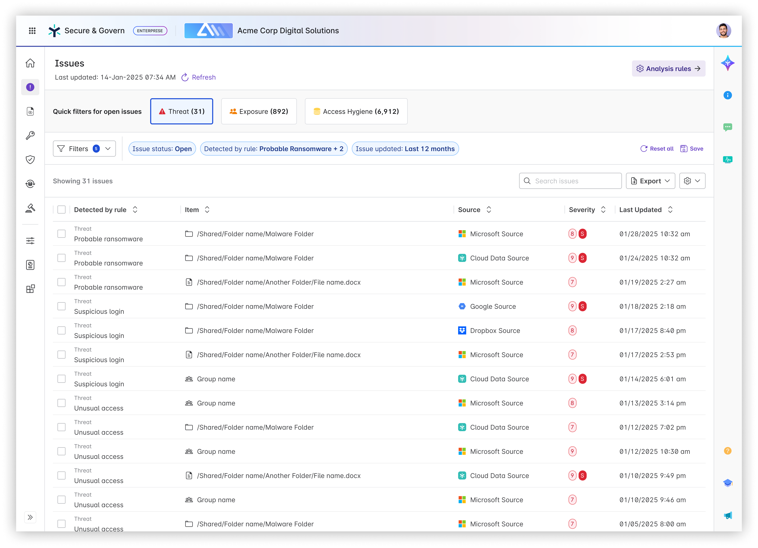
Issues - New Issue Categories
Problem Statement
Security teams are inundated with alerts - not just within Egnyte but across their security tool stack. They have limited time and people to review all alerts which can lead to true risk to the organization to be missed (alert fatigue).
User Story
As a security or IT administrator reviewing Issues, I need help determining where to focus and what is a priority.
Feature Description
Categorize existing Issue types into three categories: Exposure, Threat, and Access Hygiene. The focus will be to direct administrators towards tackling Exposure and Threat Issues first as they represent risk to the organization.
View in Productboard
DEL-42493
Link to requirements

Slide 31
S&G Folder Insights in CFS - Phase 2
Problem Statement
After providing visibility into the basic Content Lifecycle analytics we want to expand what S&G information we show users in CFS
User Story
As a user, I want to be able to access information about my files without needing to navigate to Secure & Govern
Feature Description:
• Create S&G Insight badge component placed in a Status column of the files list on the folder level
• Badge should show the number of S&G Insights for given folder
Public Summary
The folder insights feature has proven to be a valuable feature to Egnyte customers, with over 30% of eligible domains utilizing the feature in the first 2 months after release, without any type of promotion at all. We want to further increase the value of this feature by both expanding the information it presents and also displaying notifications to users when certain data thresholds are crossed
View in Productboard
DEL-41981
Link to requirements

Slide 32
Delegate Issue to Data Owner
Problem Statement
Customers that heavily use Data Owners want the ability to a delegate an Issue to a Data Owner from the Issues view or automatically via Auto-Remediation rules.
User Story
As an S&G user, I want the ability to easily assign issues to the appropriate Data Owner so that they can remediate it.
View in Productboard
DEL-44433
Link to requirements

Slide 33
Enable Power Users Folder Full access to Folders they Create
In order for a power user to have S&G visibility, the power user must have Folder Full access to the individual folders to see issues and sensitive content in their S&G instance.
This feature would delegate Folder Full access to power users for any sub-folder(s) that they create where they have Folder Editor permissions in the parent folder. This would mitigate having the Egnyte Admin user needing to do it on-demand at-request by the Power User and this also empowers the Power User from a CFS perspective to be able to have folder full access to the folders and content that they are creating and populating and as such the ability to delete any unintentionally created files in the folder that they currently only have Folder Editor privileges to.
This feature would result in the following capabilities:
1. Configuration to enable Folder Full access to Folder Editors for folder editor-created folders
In Settings, Configuration - User Types & Roles - under Power User - the following configuration should be enabled -
Configuration (bolded values are default):
Option A: Delegated Folder Full role when creating a new folder – Enabled(True,False**)**
Option B: Delegated role when creating a new folder – Picklist: (Folder Full, Folder Owner, None)
2. When the Value is True or Folder Full (depending on Option A or B) for this feature in Settings/Configuration/User Types&Roles/Power User - then any new folder created by a Folder Editor will result in the permission promotion/escalation of the newly created folder for the folder editor who created the folder to Folder Full.
3. This value will be default set to True or Folder Full (depending on Option A or B) for all domains upon release, as there should be minimal impact to existing workflows since the feature upon release will only impact newly created folders and not existing folders.
View in Productboard
CFS-63434
Missing requirements

Slide 34
External Link Auto-Remediation (Milestone 3)
PLACEHOLDER
View in Productboard
DEL-44739
Missing requirements

Slide 35
CMMC Compliance

Slide 36
*.egnytegov.com domains support for SS devices
Currently SS devices does not take *.egnytegov.com as domains as its hardcoded to *.egnyte.com domains only.
There is strong business need to support fedRAMP supported domains as more customers are opting for it and SS is the only device which is currently supported on public cloud from hybrid appliances.
View in Productboard
TRB-8299
Missing requirements

Slide 37
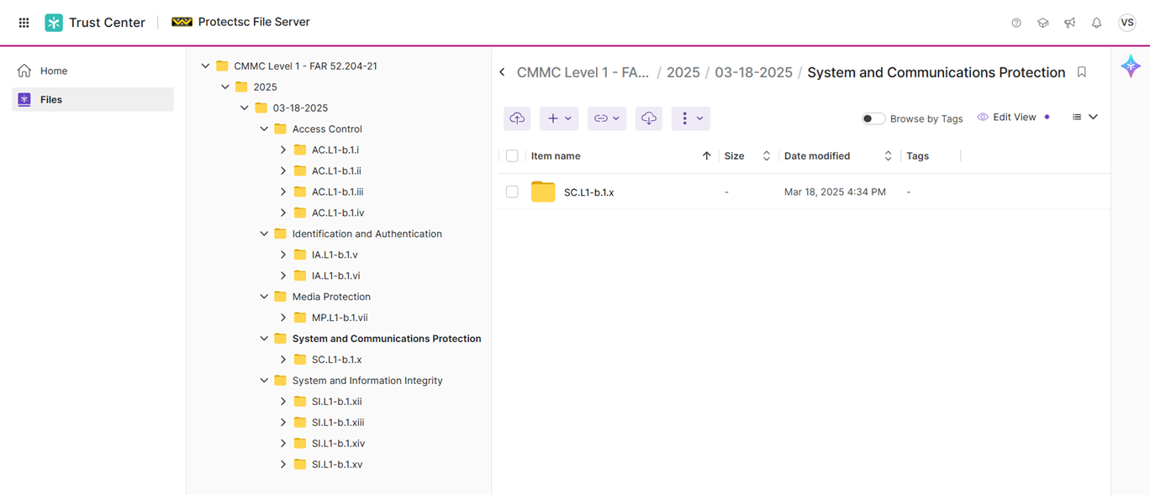
Trust Center for CMMC Level 1
Problem Statement
CMMC Level 1 is a key compliance mandate for DoD contractors and sub-contractors. Proving CMMC Level 1 compliance ensures that DoD contractors and sub-contractors can participate in DoD RFPs. Compliance Managers are required to collect evidence (or artifacts) for all CMMC Level 1 controls. This is a time and resource intensive effort often leading to human errors, guess work, and rework. Compliance Managers greatly benefit if they had a mechanism to collect such evidence automatically and on a recurring schedule (to prove continuous compliance).
User Story
As a Compliance Manager, I want to collect evidence for CMMC Level 1 controls, so that I can be CMMC audit-ready.
Feature Description
This feature includes:
• Content pack for CMMC Level 1 (Control Number, Control Family, and Control Text)
• Mapping CMMC Level 1 controls to Egnyte capabilities
• Collecting evidence for CMMC Level 1 controls
• Integration into Trust Center landing page
View in Productboard
DEL-43244
Link to requirements

Slide 38
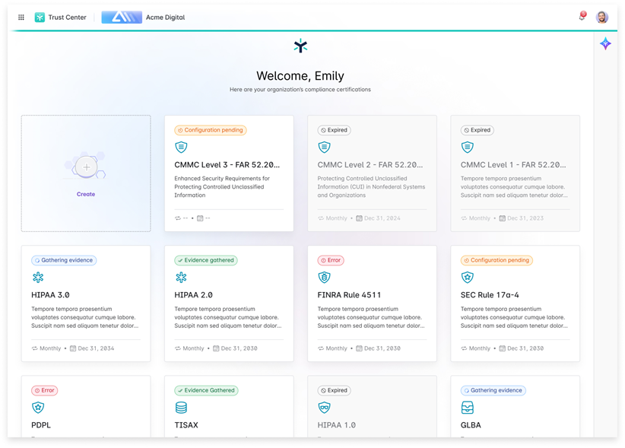
Trust Center for CMMC Level 2
Problem Statement
CMMC Level 2 is a key compliance mandate for DoD contractors and sub-contractors. Proving CMMC Level 2 compliance ensures that DoD contractors and sub-contractors can participate in DoD RFPs. Compliance Managers are required to collect evidence (or artifacts) for all CMMC Level 2 controls. This is a time and resource intensive effort often leading to human errors, guess work, and rework. Compliance Managers greatly benefit if they had a mechanism to collect such evidence automatically and on a recurring schedule (to prove continuous compliance).
User Story
As a Compliance Manager, I want to collect evidence for CMMC Level 2 controls, so that I can be CMMC audit-ready.
Feature Description
This feature includes:
• Content pack for CMMC Level 2 (Control Number, Control Family, and Control Text)
• Mapping CMMC Level 2 controls to Egnyte capabilities
• Collecting evidence for CMMC Level 2 controls
• Integration into Trust Center landing page
View in Productboard
DEL-44555
Link to requirements

Slide 39
egnytegov Support for Smart Cache
What is the problem?
CMMC customers want to deploy Smart Cache in an egnytegov.com domain
How do we solve it?
We need to ensure Smart Cache can register with a *.egnytegov.com domain and is on par in terms of functionality and performance with a Smart Cache on egnyte.com domain
View in Productboard
No Jira Link
Missing requirements

Slide 40
Introduce Gen 4 Plans

Slide 41
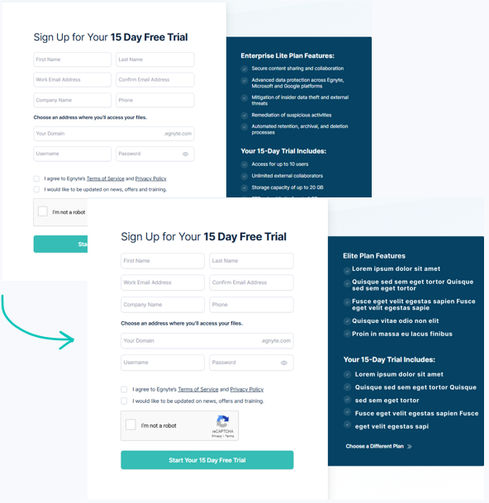
Gen 4 Launch - Trial Registration Pages
Problem:
The trial registration pages must be updated to support Gen 4 plans (Starter, Essentials, Elite). Without this, we can’t launch them as the default on the website or enable free trials.
User Story:
As a prospect, I want a straightforward and easy way to start a free trial so I can evaluate the features and benefits of Egnyte’s new plans.
Description:
Update the registration pages with the latest features and trial inclusions to provide prospects with a seamless experience and make it easier to convert them into paying customers.
View in Productboard
APPS-12215
Link to requirements

Slide 42
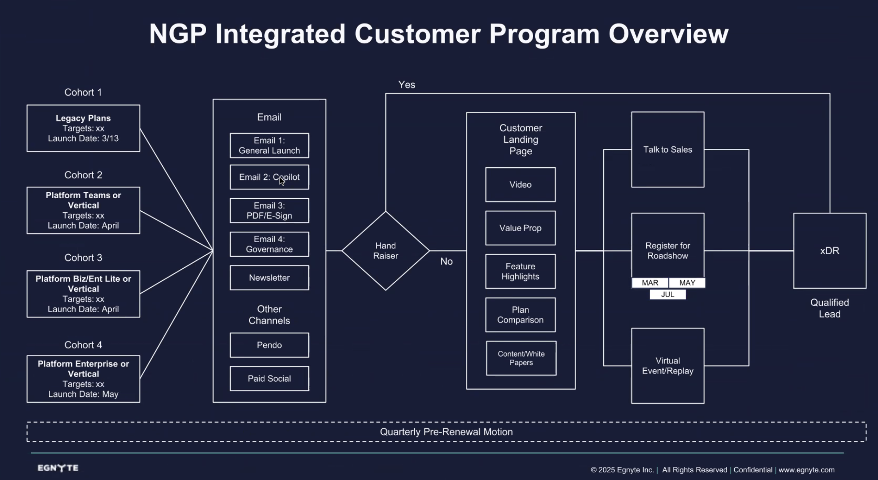
NGP Upsell from G3 and Prior
In collaboration with Marketing, we will launch a series of Pendo Upsell campaigns aligned to other marketing efforts.
View in Productboard
GR-562
Link to requirements

Slide 43
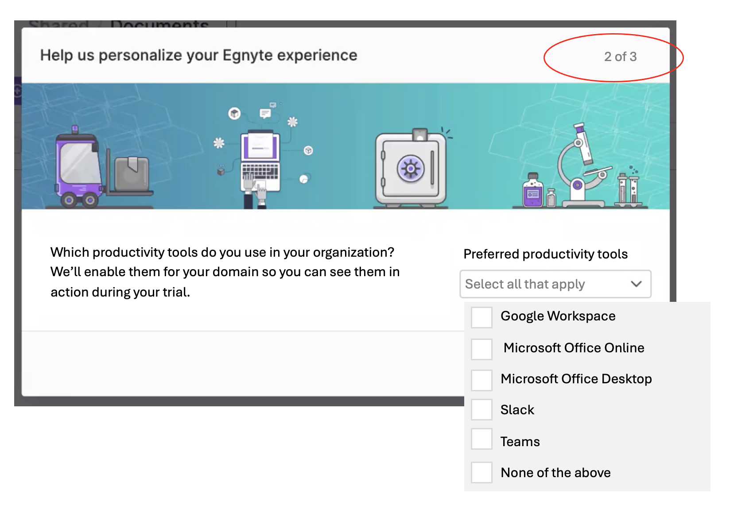
[PLG] NGP Trial Onboarding Integrations Enablement (Milestone 2.5)
See [https://egnyte.atlassian.net/wiki/x/BgBEV]
• We know that domains with 3 or more Integrations are much stickier.
• As part of the Onboarding experience, we are adding a question to the Admin Survey to determine what type of productivity tools they use. We will automatically enable the appropriate integrations (Google, MS, Slack)
• We will automatically enable other Integrations from the Egnyte App Store, based on the industry specified. Many integrations can't be enabled without input from the customer, so we will only enable a handful for each.
• Starting with the 5 industries called out in the App Store, we want to include these integrations if users select any of the following:
PINT team has completed an API for the App Store that will be used for this initiative.[https://egnyte.atlassian.net/wiki/spaces/PINT/pages/1166082078/App+Store+Configuration+API+for+Egnyte+Platform]
View in Productboard
GR-591
Link to requirements

Slide 44
[PLG] NGP Trial Onboarding Refinements (Milestone 3)
Includes a variety of refinements to the NGP Trial Onboarding experience.
• Various minor UI bug fixes, tooltips and alignment issues.
• Consolidating the first 2-3 steps
• Automatically creating a SU in Teams/Starter so we can re-introduce the "Share Folder" step
• Consolidating "Try Desktop App and Mobile App"
• Animations for the Gamification Rewards
• Unlocking file/folder templates
View in Productboard
CFS-66581
Link to requirements

Slide 45
[Usability] NGP UI Refresh (Phase 1)
This project involves introducing UI+visual design changes to the platform (all apps) towards distinguishing Next Gen 4 Plans from the previous ones. These changes are deemed necessary to coincide with the release of NGP4, hence the high priority.
Details can be found attached to this Epic -https://jira.egnyte-it.com/browse/UX-3393
Phase 1 includes:
• Comprehensive styling, content, and UI updates to the top/header bar (CFS)
• Updates to the main (left) navigation styling (CFS)
• Introducing brand-new styling to menu buttons (CFS)
• Comprehensive overhaul of the right-drawer menu bar, including brand-new colored icons (CFS)
View in Productboard
CFS-65726
Link to requirements

Slide 46
[Usability] NGP UI Refresh (Phase 2)
This project involves introducing UI+visual design changes to the platform (all apps) towards distinguishing Next Gen 4 Plans from the previous ones. These changes are deemed necessary to coincide with the release of NGP4, hence the high priority.
Details can be found attached to this Epic -https://jira.egnyte-it.com/browse/UX-3393
Phase 2 includes:
• Comprehensive styling, content, and UI updates to the top/header bar (S&G)
• Updates to the main (left) navigation styling (S&G)
• Introducing brand-new styling to menu buttons (S&G)
• Introducing the right-drawer side panel to the UI in S&G. This is also needed for delivering contextual AI + Recommendation Engine capabilities in S&G.
View in Productboard
CFS-67266
Link to requirements

Slide 47
NGP UI Refresh S&G
Requirements for UI Refresh Alongside the Introduction of the New Generation of PlansChanges Applicable Only to Users on Domains Switched to the New Plans:
1. Refreshed top bar
Changes Visible to All Plans:
1. Updated styling for the left navigation bar elements: larger icons (20px) and added background color for the active menu item.2. Refreshed button styles to enlarge the size of the icons to 20px3. Add Right Drawer component4. Relocation of Help Center / Egnyte University / Product Updates entry points to the right drawer.
Figma Designs:https://www.figma.com/design/AXtKz4IExGp3WfTjTZqSrN/Platform---Home-page-redesign-across-verticals?node-id=1726-35543&t=Xw9ungNWCco75ZRd-1
View in Productboard
DEL-44118
Link to requirements

Slide 48
Document Portal Enhancements

Slide 49
Optional documents
Problem Statement
There is no way to mark the document optional within the template. To complete the request, an uploader must add all the documents from the template.
User Story
As an Egnyte Domain Administrator or a power user with an assigned role, I would like to mark a specific document optional within the template So that the uploaders can complete the upload request even if that document is skipped
Feature Description
• Allow users to mark a document as optional as part of the template.
• The optional document can be skipped by an uploader and all the actions should be recorded in the audit report.
View in Productboard
CFS-67185
Link to requirements

Slide 50
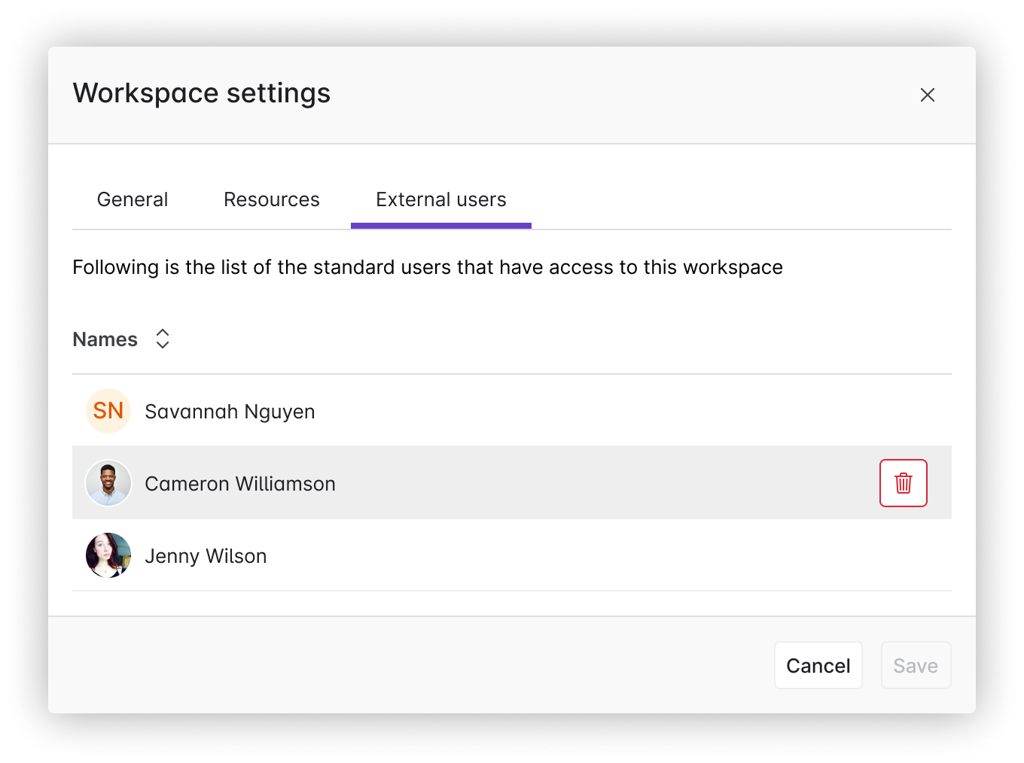
External User Management
Problem Statement
Once a Standard User is added to a workspace there is no way to remove them and they are no longer able to access Collaborate
User Story
As a user, I want to be able to remove Standard Users from a workspace, so that they can access Collaborate
Feature Description
• Provide external user management screen in Workspace Settings that shows external users and allows you to remove them
• If a Standard User is removed from a workspace they should be able to access Collaborate (unless they are associated with other Workspaces)
View in Productboard
CFS-65920
Link to requirements

Slide 51
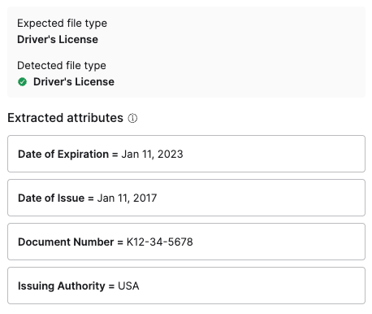
Upload request metadata extraction
Problem Statement
External users add document via upload requests, often as photos of documents, and then our customers need to review those documents and often pull out key fields and enter them into other systems. This can be challenging and time consuming.
User Story
As a user reviewing documents from an upload request, I want the system to extract key fields from documents so that I can pull that information out of Egnyte easily.
Feature Description
• Automatically extract key fields from documents submitted via an upload request
• Keep data encrypted at rest as it may be sensitive
View in Productboard
CFS-67495
Link to requirements

Slide 52
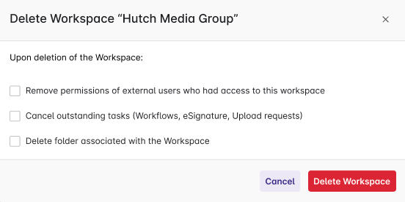
Deleting a Workspace
Problem Statement
Customers create workspaces and then realize that either they chose the wrong folder or don't want the folder to be treated as a workspace. Today there is only a way to deactivate the workspace, but not remove it.
User Story
As a user I want to delete a workspace so that the folder is treated as a normal folder in Collaborate
Feature Description
• Add new action to workspace settings to delete the workspace
• Provide options to delete the folder and to remove external access
View in Productboard
CFS-63196
Link to requirements

Slide 53
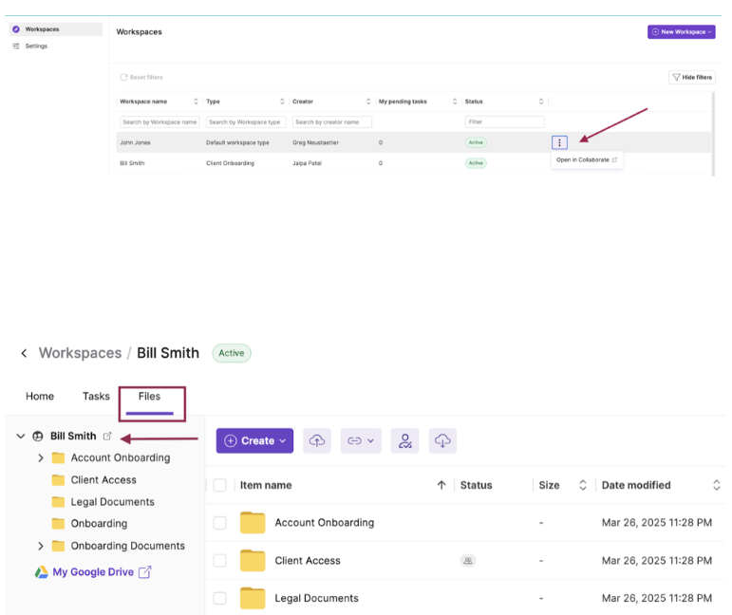
Open Workspace folder in Collaborate
Problem Statement
Users cannot easily find or navigate to collaborate folder associated with a Workspace.
User Story
As as internal user I want to quickly navigate to Collaborate folder from a Workspace I am working on so that I can interact within Collaborate easily.
Feature Description
Users will be given an option to navigate to Collaborate folder from a Workspace.
View in Productboard
CFS-66567
Link to requirements

Slide 54
Enhanced AI copilot

Slide 55
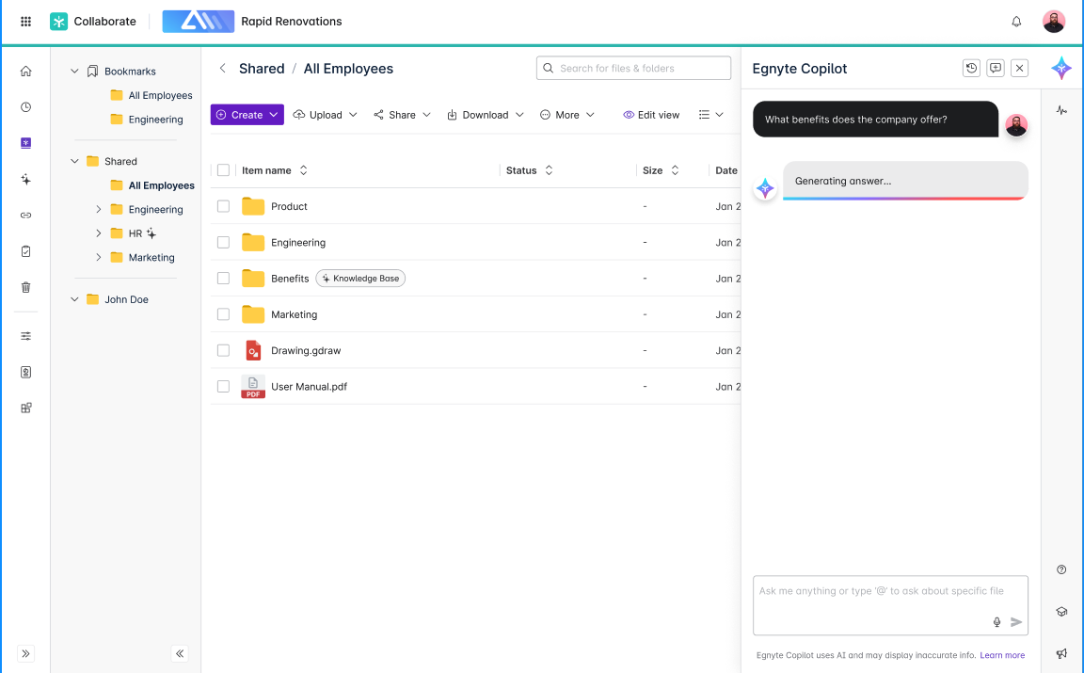
[Copilot] Improved Loaders / Streamed responses
Problem Statement
Users experience uncertainty or frustration when Co-Pilot responses take longer to generate. As we wait for the LLM to generate the complete answer & there is limited visual feedback during this period leads to a poor UX.
User Story
As a user, I want to see visual indicators (animations/loaders) and receive streamed responses while the Co-pilot generates an answer, so that I feel confident the system is working and can start consuming information faster.
Feature Description
• Introduce animated loaders and display helpful loading text during AI response generation in Copilot and Knowledge Base.
• Loaders update state every 2 seconds until streaming begins.
• When streaming starts, loaders disappear, and the response is displayed progressively.
Embedded content
View in Productboard
CFS-67395
Link to requirements

Slide 56
S&G Co-pilot - Phase 1 - Helpdesk & Blogs
This would basically be scanning through Helpdesk and Blogs to answer secuitry specific questions. Currently the helpdesk built on CFS is defunct (legacy tech). Team is trying to user vertex ai to tune for better results.
This also introduces the Co-pilot UX into S&G as an entry point.
View in Productboard
DEL-44757
Missing requirements

Slide 57
S&G Sensitive Content Skill
Followed by CLM, we want the users to now be able to query Sensitive Content details at the folder level. More details specific concerning the extent of results that can be extracted is documented in the linked ticket.
View in Productboard
DEL-44323
Missing requirements

Slide 58
Build Pax8 Distributor Program

Slide 59
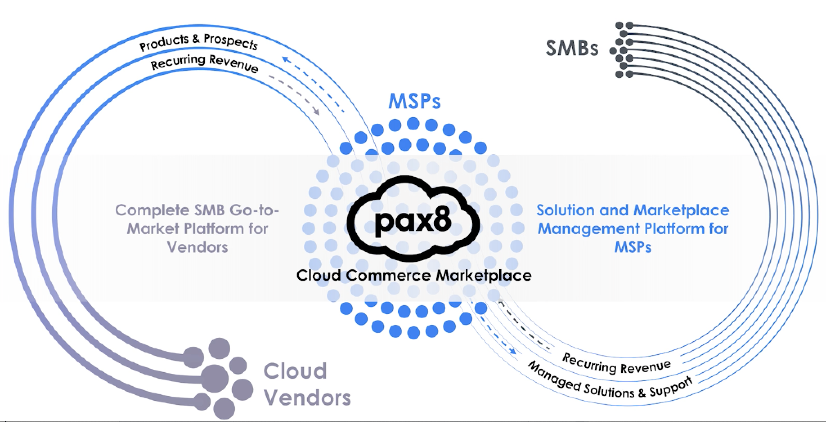
Distribution model - new type of resellers
Problem Statement
Egnyte is starting cooperation with Pax8 who owns a marketplace for MSPs offering multiple products from a variety of vendors. To support this integration, internal and customer facing applications need to be adjusted.
User Story
As an Egnyte staff user I want to manage a Pax8 MSP so that Egnyte can sell products through a Distributor.
Feature Description
• Distinguish MSP partners as managed by Pax8 Distributor
• Allow Egnyte internal staff users to manage such MSPs in the Reseller dashboard
• Simplify onboarding and approval process (plan category, Pax8 planset, no CC required)
• Exclude such partners from financial processes (payments, invoicing)
• Adjust existing MSP Reseller dashboard for such partners allowing them only to:
View in Productboard
APPS-12865
Link to requirements

Slide 60
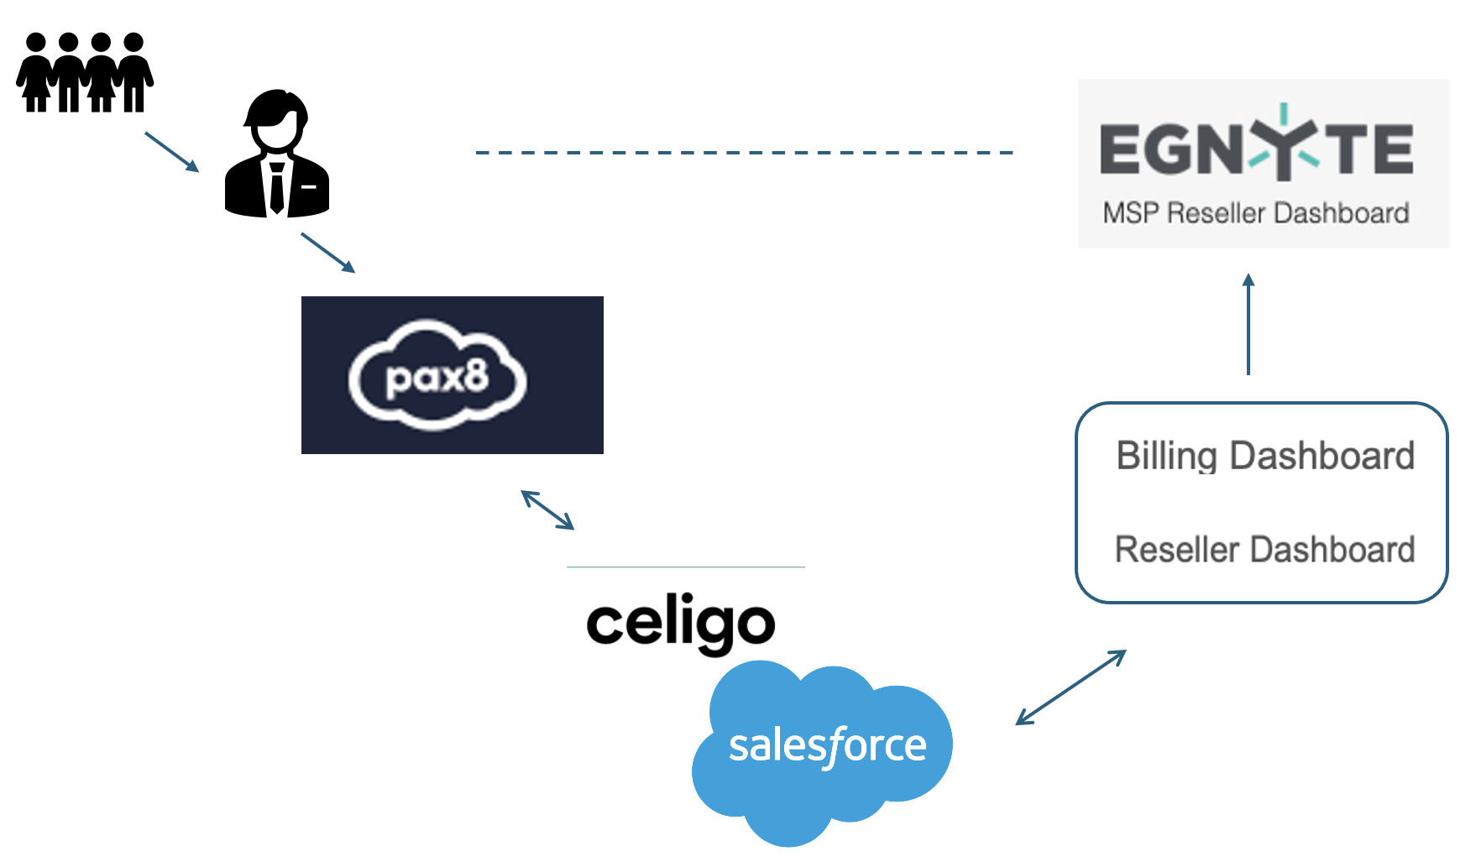
Distribution model - automatic deployments - part 1
Problem Statement
Egnyte integrates with Pax8 through SFDC. SFDC will be the recipient of requests sent from Pax8 and will be a dispatch system to provide deployment requests and data to downstream systems.
Reseller and Billing apps need to be prepared to respond to such requests and act accordingly automatically.
User Story
As Egnyte Internal system I need to provide automated deployment of Egnyte products for Pax8 Managed MSPs so that deployment requests can be done without manual support from the Finance Team.
Feature Description
• Provide automated deployment for first part of transactions requested from SFDC:
View in Productboard
APPS-12970
Link to requirements

Slide 61
Productivity Agents

Slide 62
AI Prompt workflow step
Problem Statement
Document-based workflows often rely on manual review to extract insights, which slows down operations and introduces inconsistency across teams. There's a growing need to scale knowledge extraction without adding headcount.
User Story
As an Egnyte user managing content workflows, I want to automatically execute customer-provided GenAI prompts within documents, so that I can generate structured metadata, comments, or insights without manual effort.
Feature Description
• Integrate GenAI into document workflows to extract structured outputs (e.g., metadata, workflow comments)
• Support flexible prompt injection from users or templates for targeted insight generation
• Reduce time to insight and improve consistency across teams handling unstructured content
View in Productboard
CFS-66199
Link to requirements

Slide 63
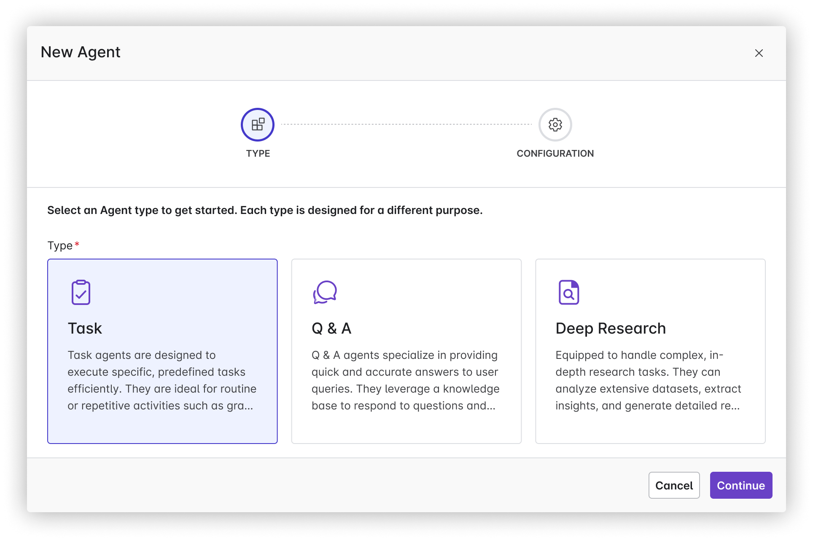
Deep Research Agent (Bryce)
Problem Statement
Businesses and researchers often struggle with the time-consuming task of conducting in-depth analysis and research, such as finding historical data or identifying trends from previous projects. This lack of efficiency can delay decision-making processes, harming productivity.
User Story
As a business analyst, I want a Deep Research Agent that can quickly identify similar proposals and investments by analyzing historical data, so that I can accelerate the research process and make more informed decisions based on past trends.
Value Statement
• Time Savings: Automates the labor-intensive process of sifting through historical data, drastically reducing the time spent on research from months to mere days or hours.
• Increased Productivity: Allows employees to focus on higher-value tasks by automating repetitive research activities.
• Cost Efficiency: Reduces the need for extensive manual labor, resulting in lower operational costs associated with research and analysis.
View in Productboard
CFS-67394
Link to requirements

Slide 64
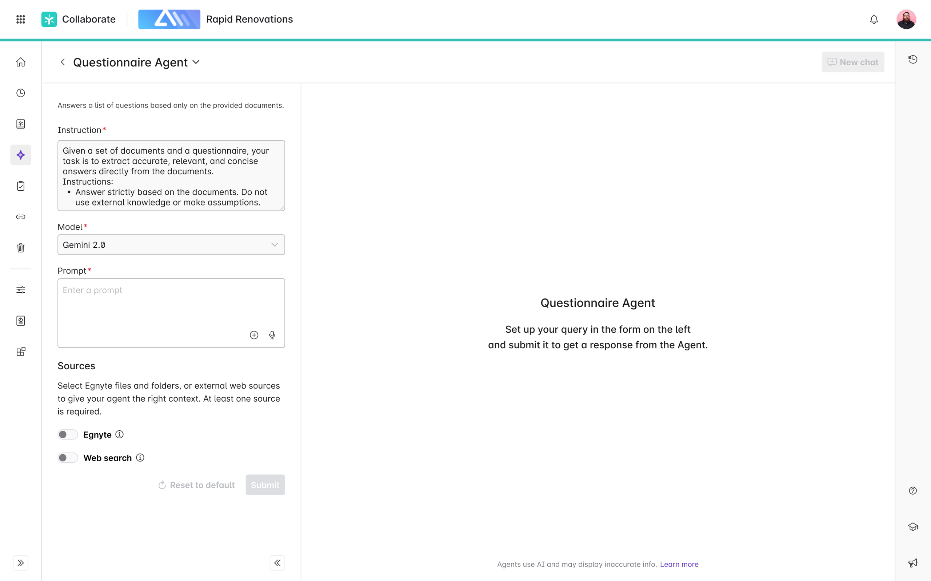
[Agent] Questionnaire Agent (Bryce)
Problem Statement
Users frequently receive lists of questions from clients regarding products, services, and compliances, which require significant time and effort to answer.
User Story
As a user, I want to submit a list of questions (text, excel, pdf, doc) to a Questionnaire Agent and point it to a collection of documents in Egnyte (files or folders) that contain the answers.
Value Statement
• Time Efficiency: Automates the process of finding answers to repetitive questions, significantly reducing the time spent on each information request.
• Enhanced Productivity: Allows users to focus on higher-value tasks by freeing them from the repetitive chore of answering similar questions.
View in Productboard
CFS-67393
Link to requirements

Slide 65
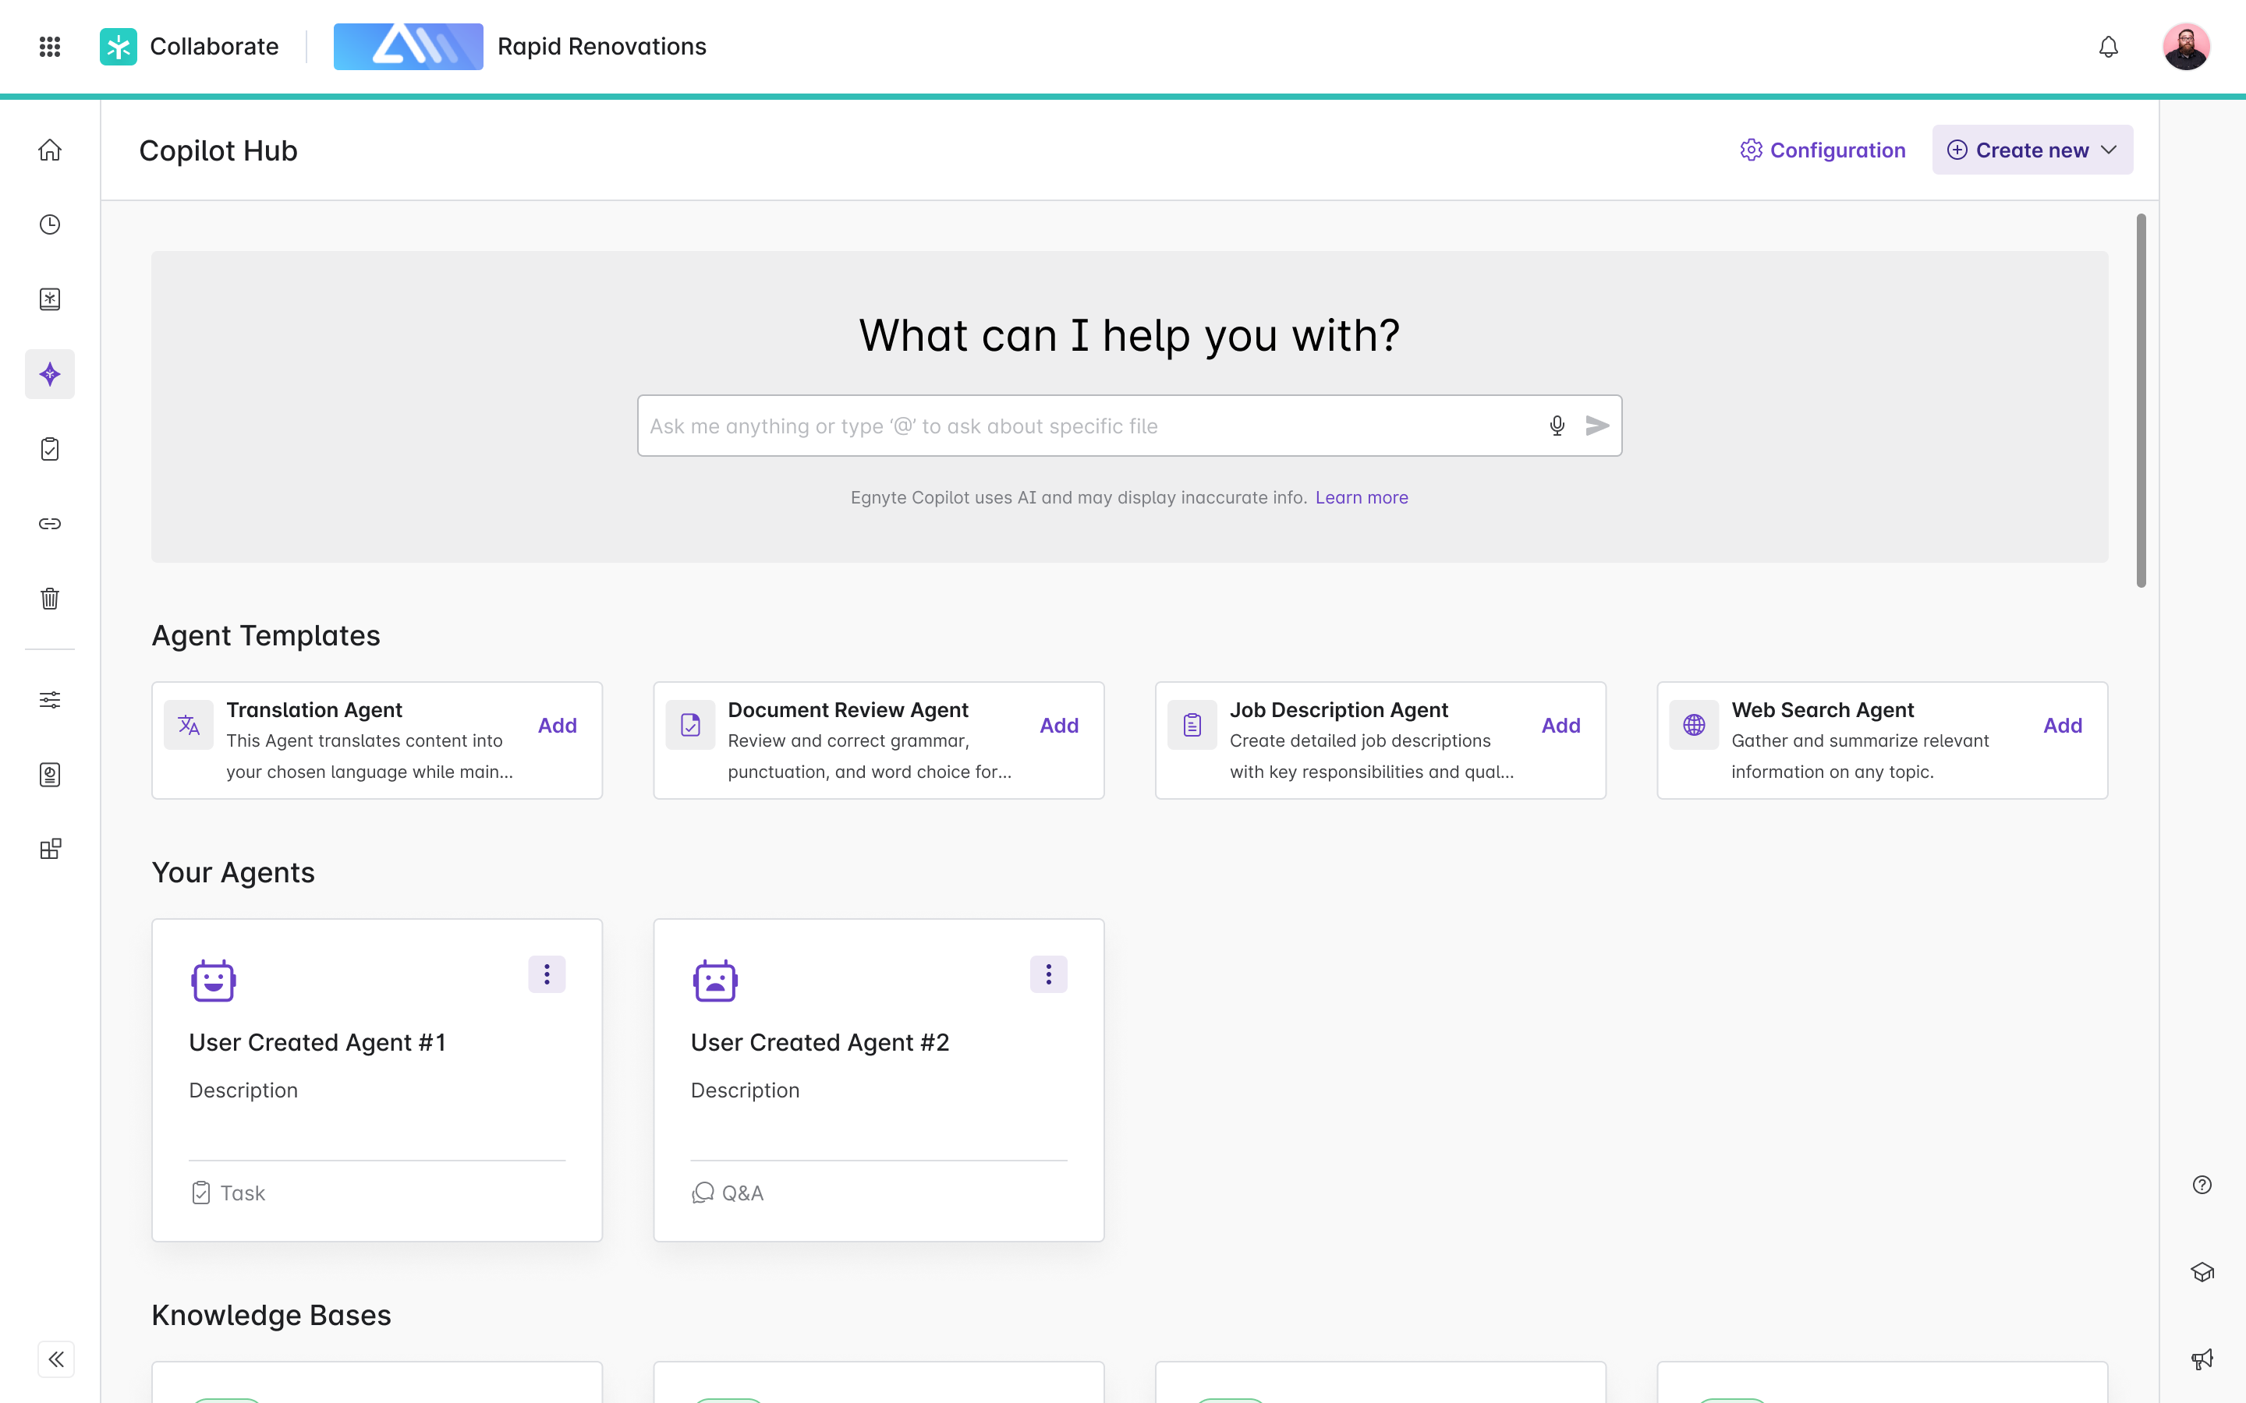
[Agent] Agent Templates in Copilot hub
Problem Statement
New users often face challenges when adopting AI agents due to lack of familiarity and difficulty in configuring them to meet specific needs. This initial barrier can slow down the adoption process, reducing the potential benefits of task automation.
User Story
As a new user of the AI Agents platform, I want pre-configured agent templates available at the start, so that I can quickly set up and begin using these tools without needing extensive customization, thereby experiencing the benefits of automation sooner.
Value Added
• Faster Onboarding: New users can quickly get started with minimal setup time, which reduces the learning curve and speeds up adoption.
• Ease of Use: Pre-configured templates simplify the initial experience, making it less intimidating for users who are not tech-savvy.
• Immediate ROI: Users can achieve immediate productivity gains from automation, showcasing the value of AI agents promptly.
• Flexibility: While templates provide a good starting point, they can be customized later as users become more comfortable with the platform.
• Increased User Satisfaction: Easy access to ready-made solutions enhances user experience and satisfaction, encouraging continued use and exploration of more advanced functionalities.
Agent Template examples:
• Translation Agent:
• Document Review Agent:
• Job Description Creation Agent:
• Web Search Agent:
Requirements
https://egnyte.atlassian.net/wiki/spaces/CFS/pages/1227161693/Agents+Introduction+in+Copilot+Hub
Figma:
https://www.figma.com/design/k96o3kXukaVrAUtsaPhN4H/Egnyte-Platform-Copilot---2025?node-id=24179-230269&t=Rc2JPK6PsbVBlXNe-0
Design:
https://egnyte.atlassian.net/wiki/spaces/CFS/pages/1304788999/Agents+Integration
Feature flags:
*server.SmartAppAgentsPowerUserAccessEnabled*
*server.SmartAppAgentsEnabled*
View in Productboard
CFS-65268
Link to requirements

Slide 66
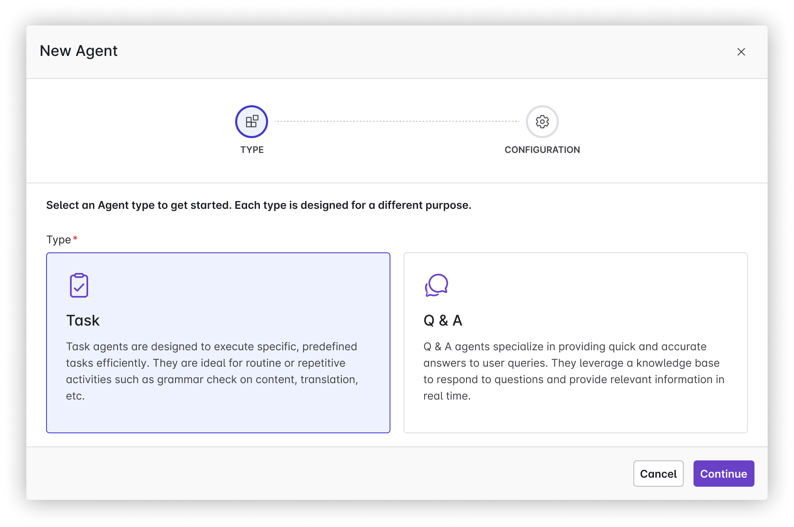
[Agent] Custom Agents in Copilot hub
Problem Statement:
Many businesses are burdened by time-consuming and repetitive tasks that reduce overall productivity and employee engagement. This inefficiency prevents employees from focusing on higher-value work that could contribute more significantly to the company's growth and success.
User story:
As a business owner, I want AI agents to automate repetitive and time-consuming tasks so that my employees can focus on strategic and creative efforts that drive the business forward.
Value Statement:
• 24/7 operational capability, ensuring tasks are completed even outside regular business hours.
• Increased productivity as employees can refocus their time on more valuable activities.
View in Productboard
No Jira Link
Link to requirements

Slide 67
Specialized Agents - AEC

Slide 68
Smart Specifications - In Product Version
Problem:
Construction specifications are extremely long, detailed and complex PDF's accessed by different user-roles such as Project Managers, Estimators, VDC and more. Users find it challenging to locate and extract relevant information from the Specs.
User Stories:
1. As a Project Manager / Estimator / VDC team member, I want to open the Smart Spec preview when selecting my specification files, so that I can quickly find the section I’m looking for
2. As a PM / Estimator / VDC, I want to ask a natural language query about my specification, so that I can quickly find the information I am looking for.
Description:
Egnyte's AEC doc-classification will automatically identify and tag Specs within a project. When a user clicks on the tagged specification in WebUI, the Smart Specs will automatically load in the preview pane. The user will see all the sections within the Spec on the left panel. When they click on a specific section in the left panel, the center panel will open that specific section. On the right panel, they can ask natural language queries on the spec.
Requirements:https://egnyte.atlassian.net/wiki/spaces/AEC/pages/446464310/Smart+Specification+Requirements
Figma
https://www.figma.com/design/pSP6gVOM1NB1dORHzVw1k5/AEC-Trial-Onboarding?node-id=7-17521&node-type=frame&t=2GCW5Ubc2U9ardCl-0
JIRA:https://jira.egnyte-it.com/browse/CFS-60040
FEATURE FLAG:features.server.SmartSpecFeatureEnabled
View in Productboard
CFS-60040
Link to requirements

Slide 69
[Agent] Codebooks Agent for AEC
Problem:
Users in the AEC industry require to follow regulations and standards during the design / construction / maintenance of structures and these are stipulated as building codes. These building codes are extremely long, detailed and complex, can vary by local jurisdictions and can change from year to year. Due to these factors, users often face the challenge of finding the right code information pertaining to a project, and using that information to validate project specifications, submittals and other project docs.
Use-Cases:
1. As a project engineer / field engineer, I want to easily get answers to regulatory questions, such as
2. As a project coordinator, I want to easily validate a spec against regulations/codes
Description:
We will create a specialized agent, the code books agent, which the admin can configure to read one or more code books at a specific location on their Egnyte domain. Once configured, users can ask questions against the code book agent from the WebUI or desktop
View in Productboard
CFS-64858
Link to requirements

Slide 70
Co-Editing Enhancements

Slide 71
[Usability] Disable File Actions During Co-Edit Session
Requirements
• Disable the following file actions in the context menu and in preview if available when the co-editing session is in progress.
• The proper tooltip should indicate that the action is disabled as the file is being edited.
View in Productboard
CFS-67870
Link to requirements

Slide 72
Product-Led Growth

Slide 73
Recommendation Engine Test Campaigns
Continue testing the Recommender against Pendo in a series of campaigns.
View in Productboard
GR-578
Missing requirements

